Slide 1
Version 1.0

Slide 2
DISCLAIMER
This information is not exhaustive and is provided to assist first responders and does not establish or create a standard of care, nor enhance applicable legal standards of care.

Slide 3
INTRODUCE YOURSELF
IPICD-qualified
Spit Restraint Device™ Instructor

Slide 4
Program Is Important To You
Cognitive Domain training on spit-restraint devices.
Understanding that a spit-restraint device application is a use of force that must comply with applicable legal standards of care.
Understanding that a spit-restraint device application may be a de-escalation strategy.

Slide 5
GOALS
To educate law enforcement officers and others about spit-restraint devices.
To educate law enforcement officers and others about force and other relevant standards that may govern the application of use, removal, retention, and disposal of spit- restraint devices.
To educate law enforcement officers and others about the limitations of spit-restraint devices.

Slide 6
GOALS
To educate law enforcement officers and other about spit-restraint device application, use, removal, and retention for potential evidence.
To quantitatively evaluate program learners about their spit-restraint device knowledge.

Slide 7
Discuss YOUR AGENCY’S
Spit Mask Written Policy and Guidelines
Spit Mask Competency-based Quantitative Training?

Slide 8
DISCUSS and SHOW YOUR AGENCY’S
APPROVED
SPIT
RESTRAINT
DEVICE

Slide 9
HAND OUT TO EACH LEARNER
IPICD Spit-Restraint Device Learner Companion

Slide 10
SPIT MASK DEFINED
A commercially manufactured, single use, protective, generally synthetic small woven mesh device that is physically placed over a person’s head and facial areas.
Intended use: To prevent or reduce the transmission of oral, nasal, and/or facial bodily fluids (e.g., blood) to minimize the spread of infectious disease that may be caused by human spitting, biting, or physical contact.
Not included: Respirators; COVID-19 and similar face masks; prisoner hoods.

Slide 11
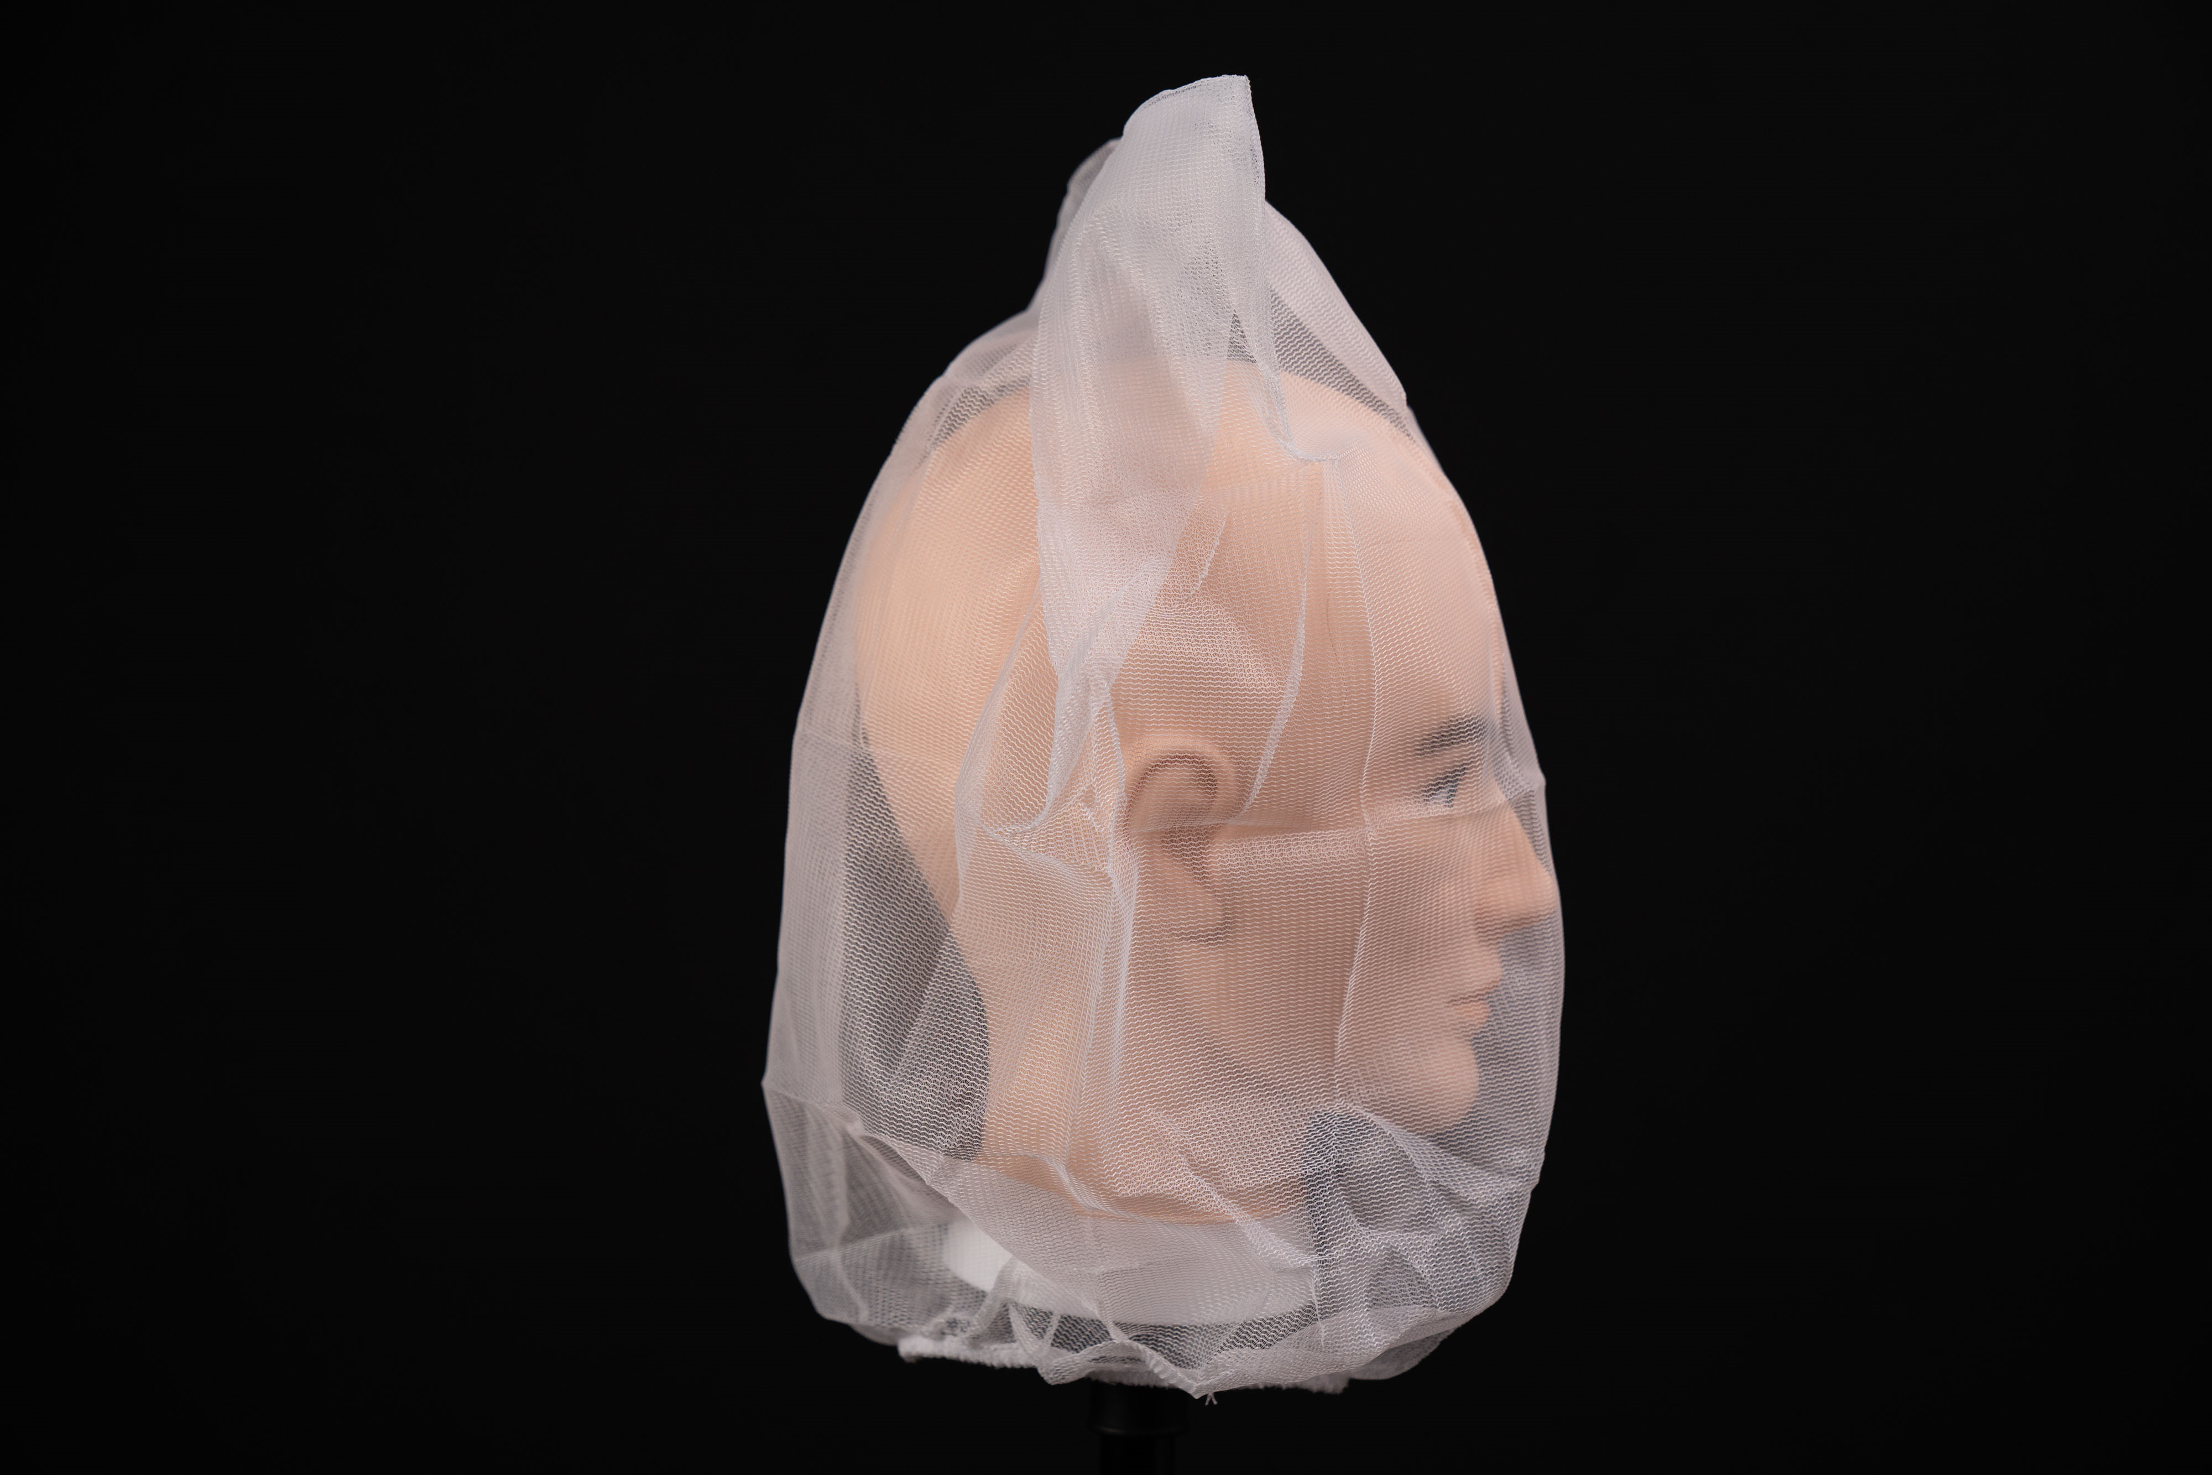
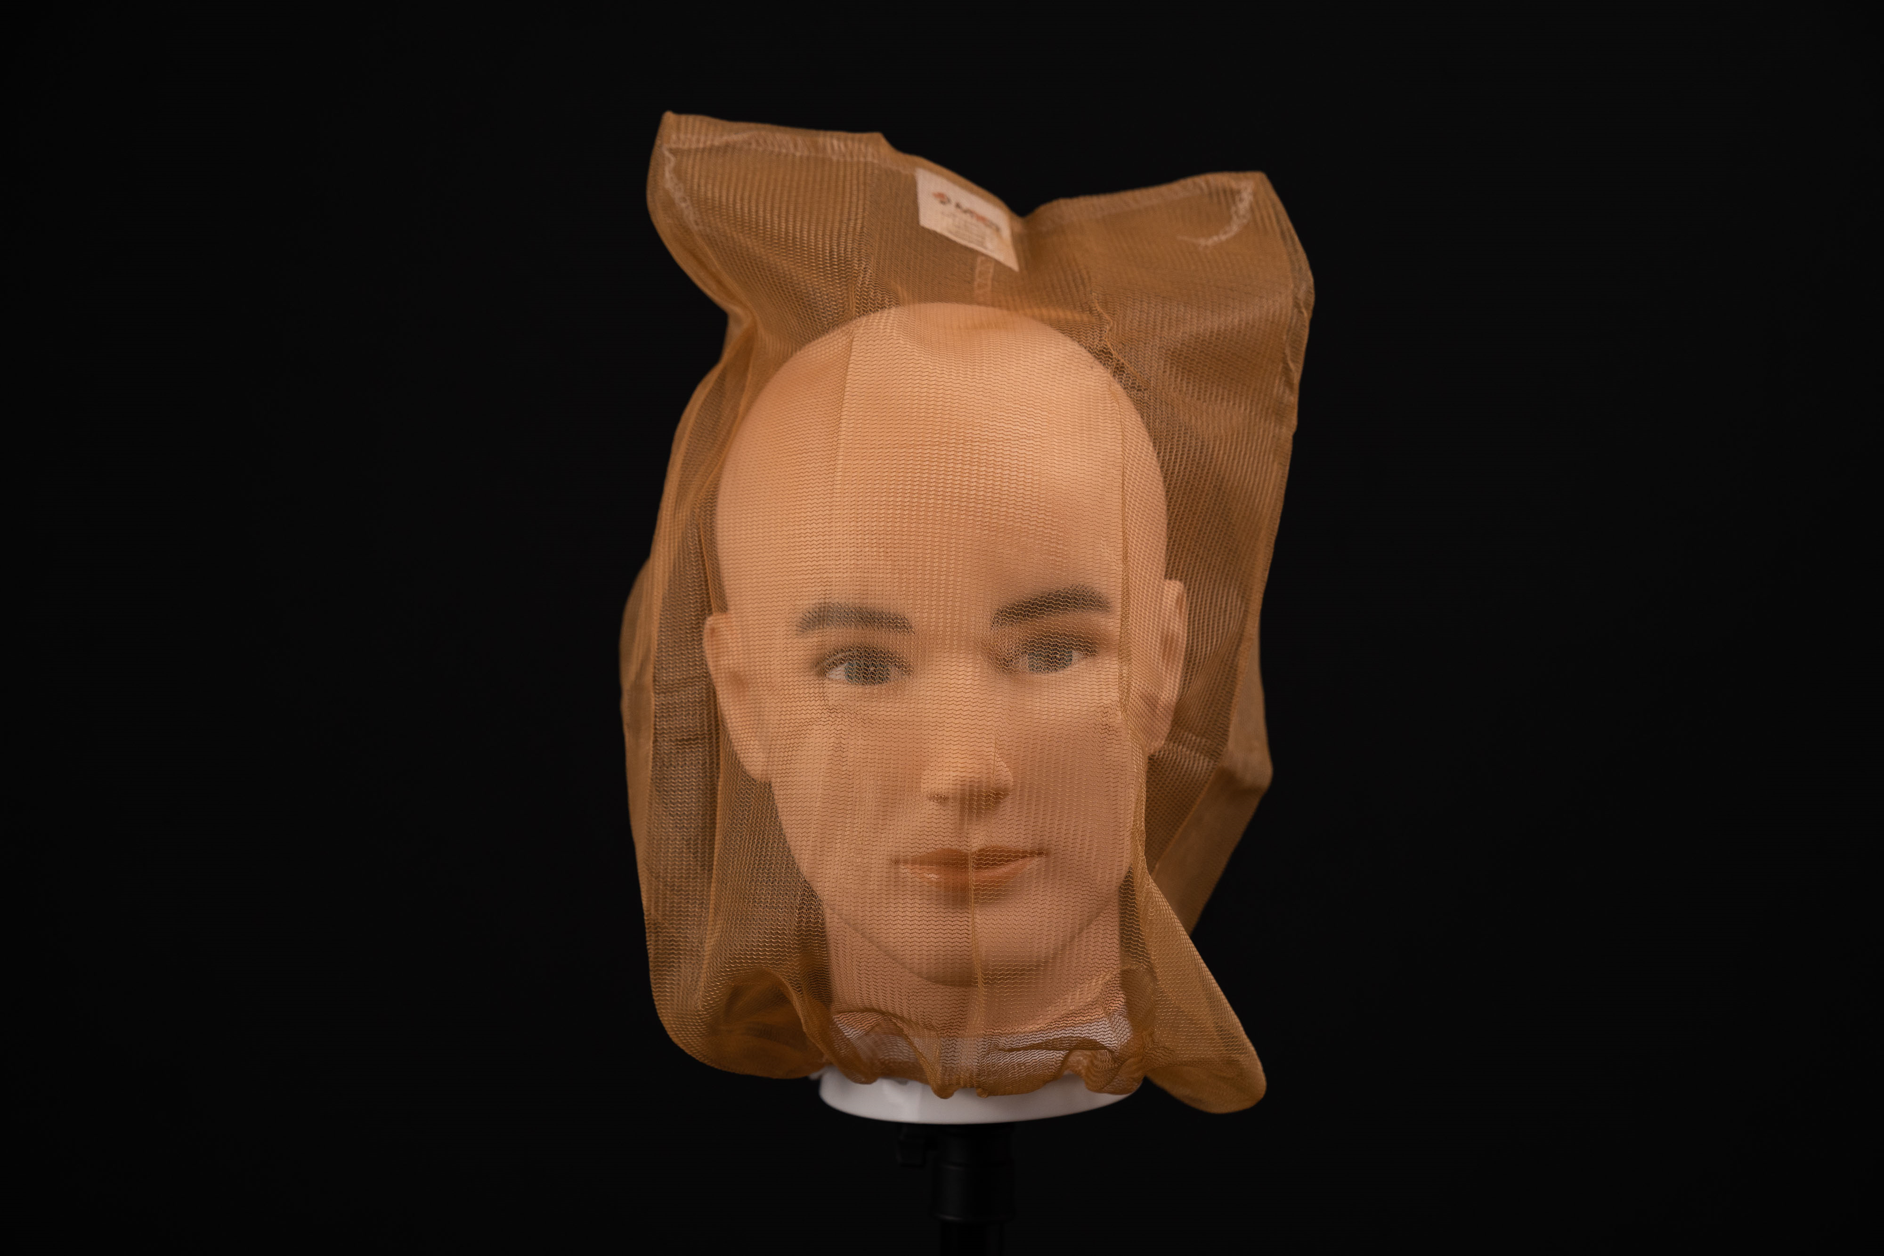
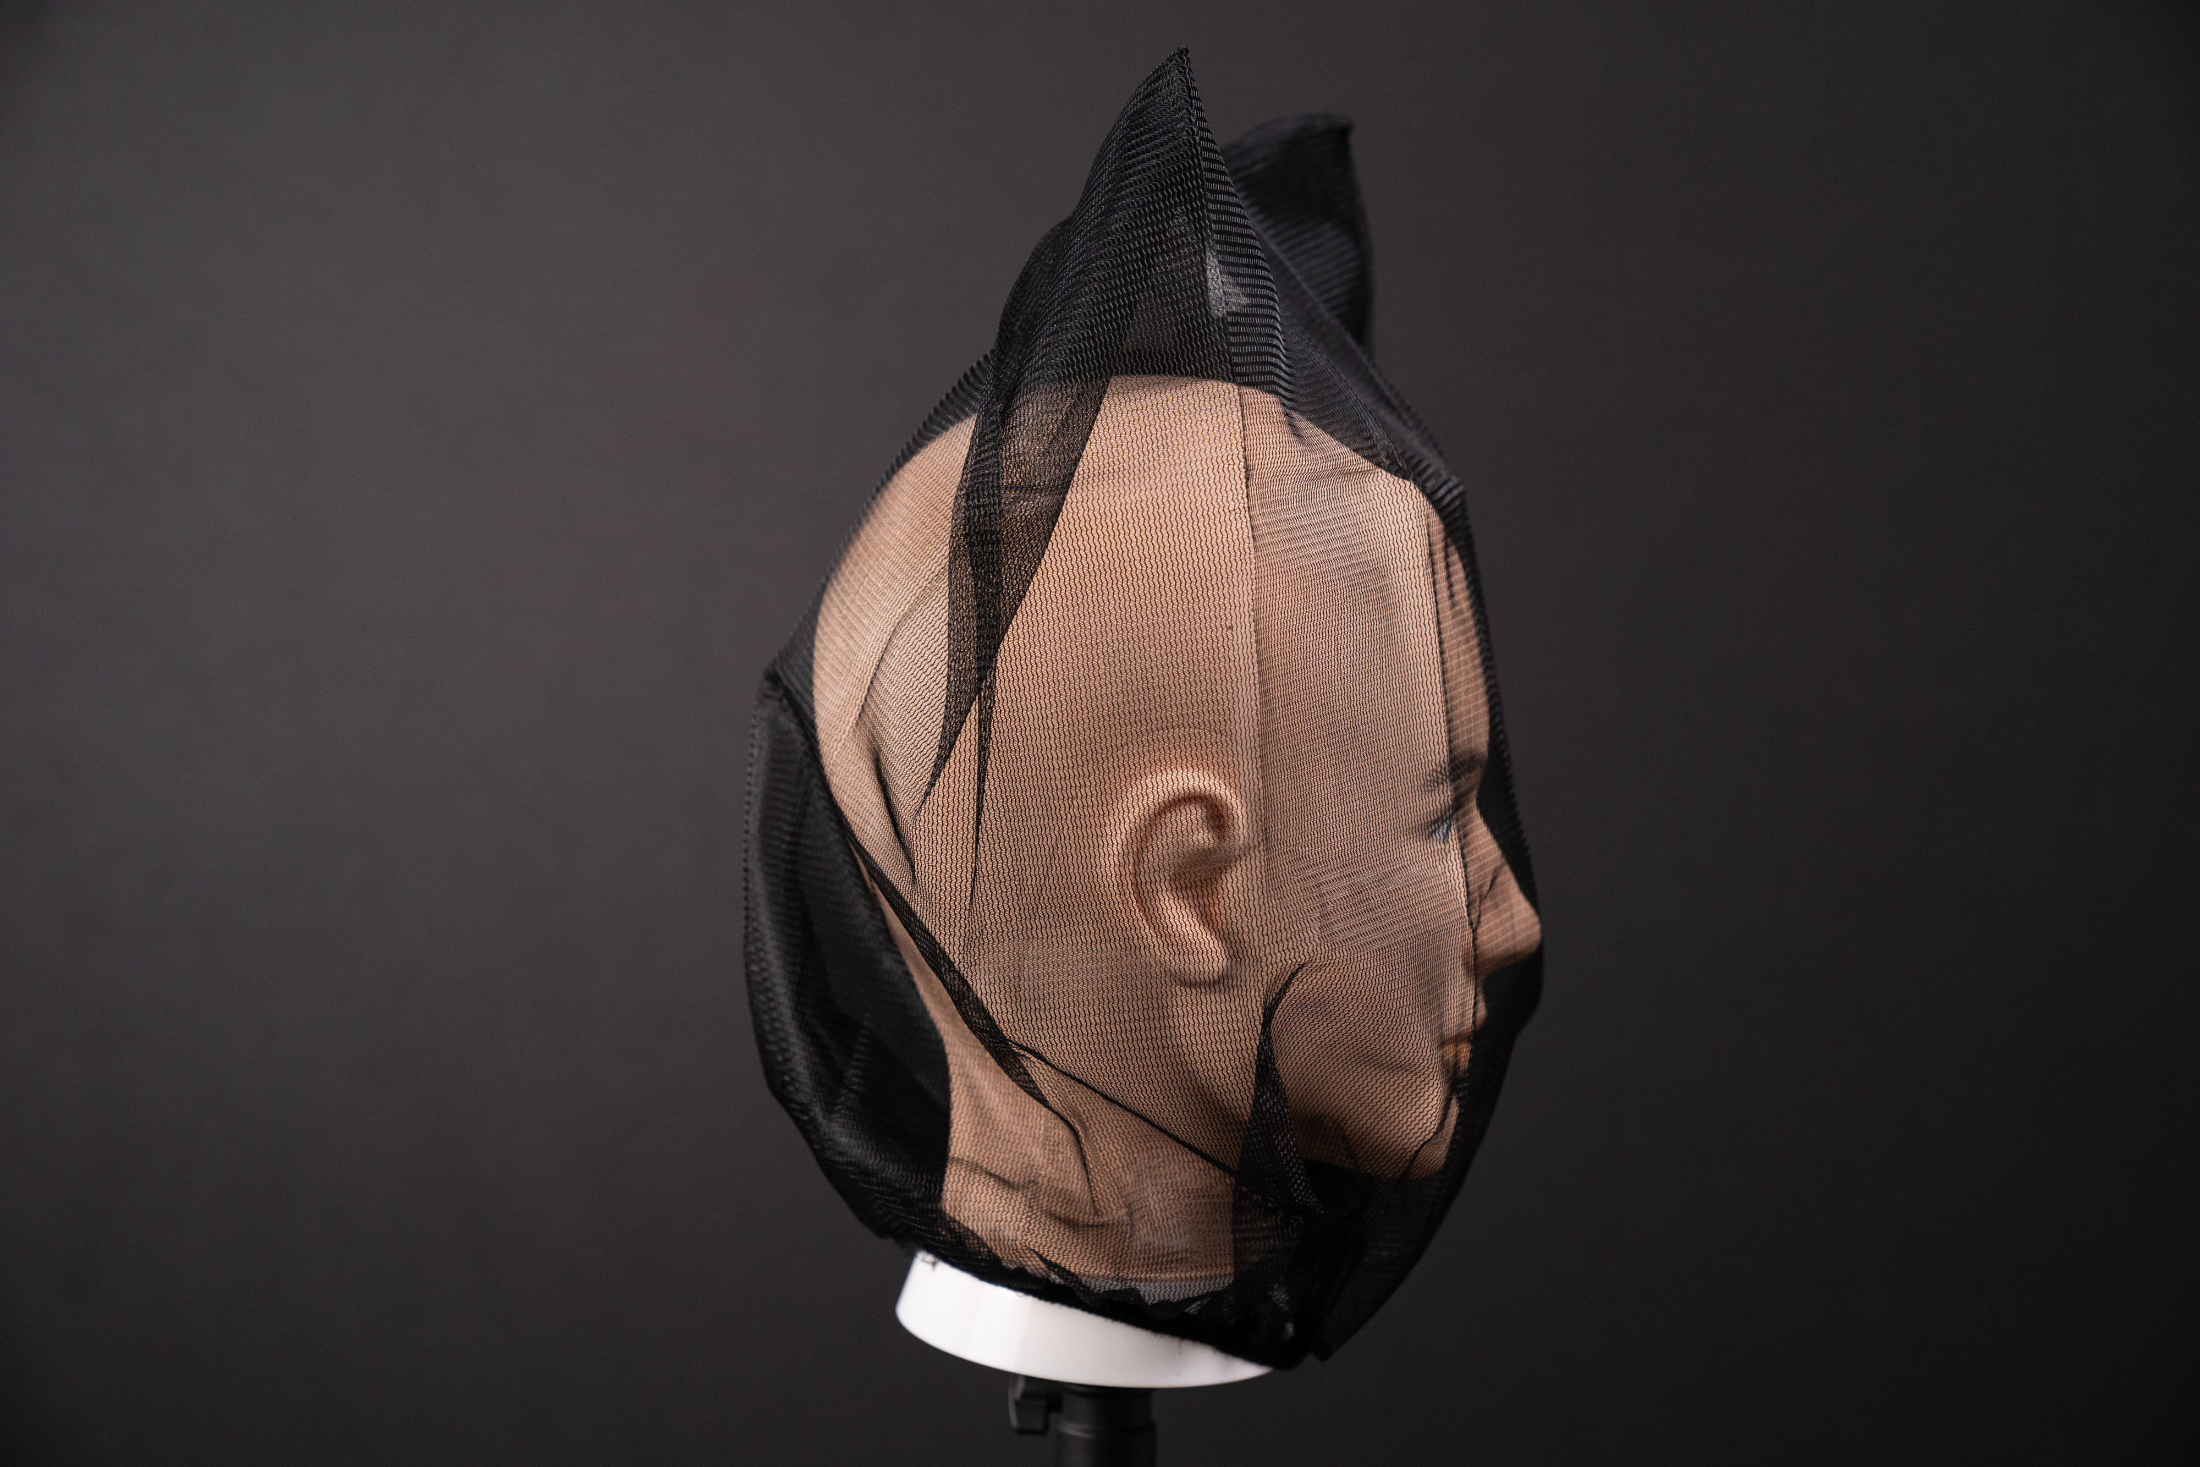
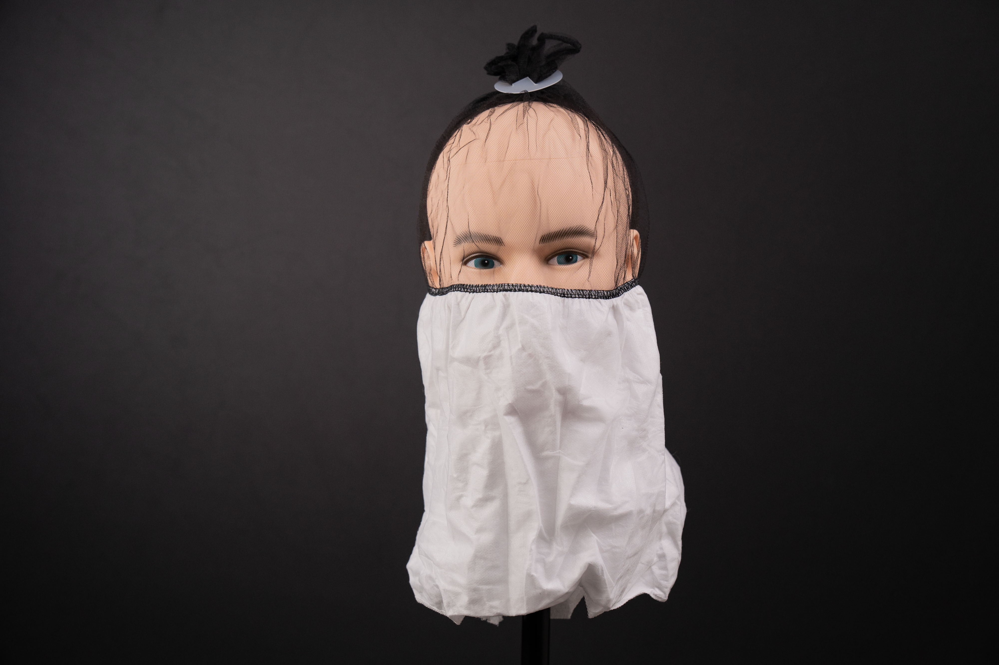
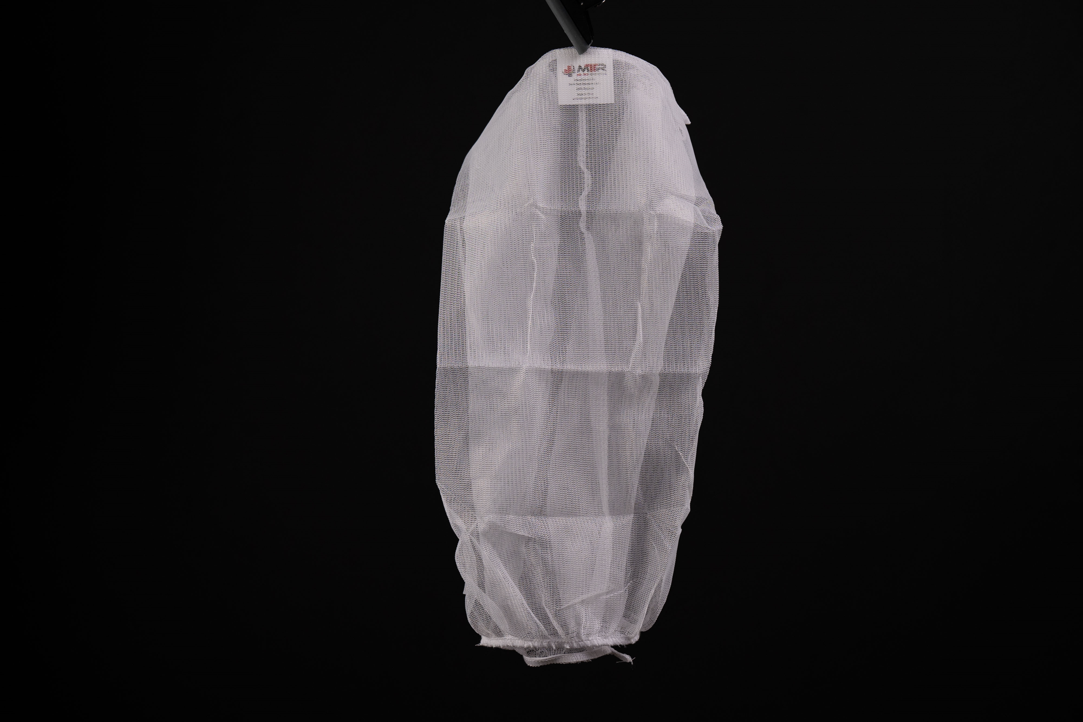
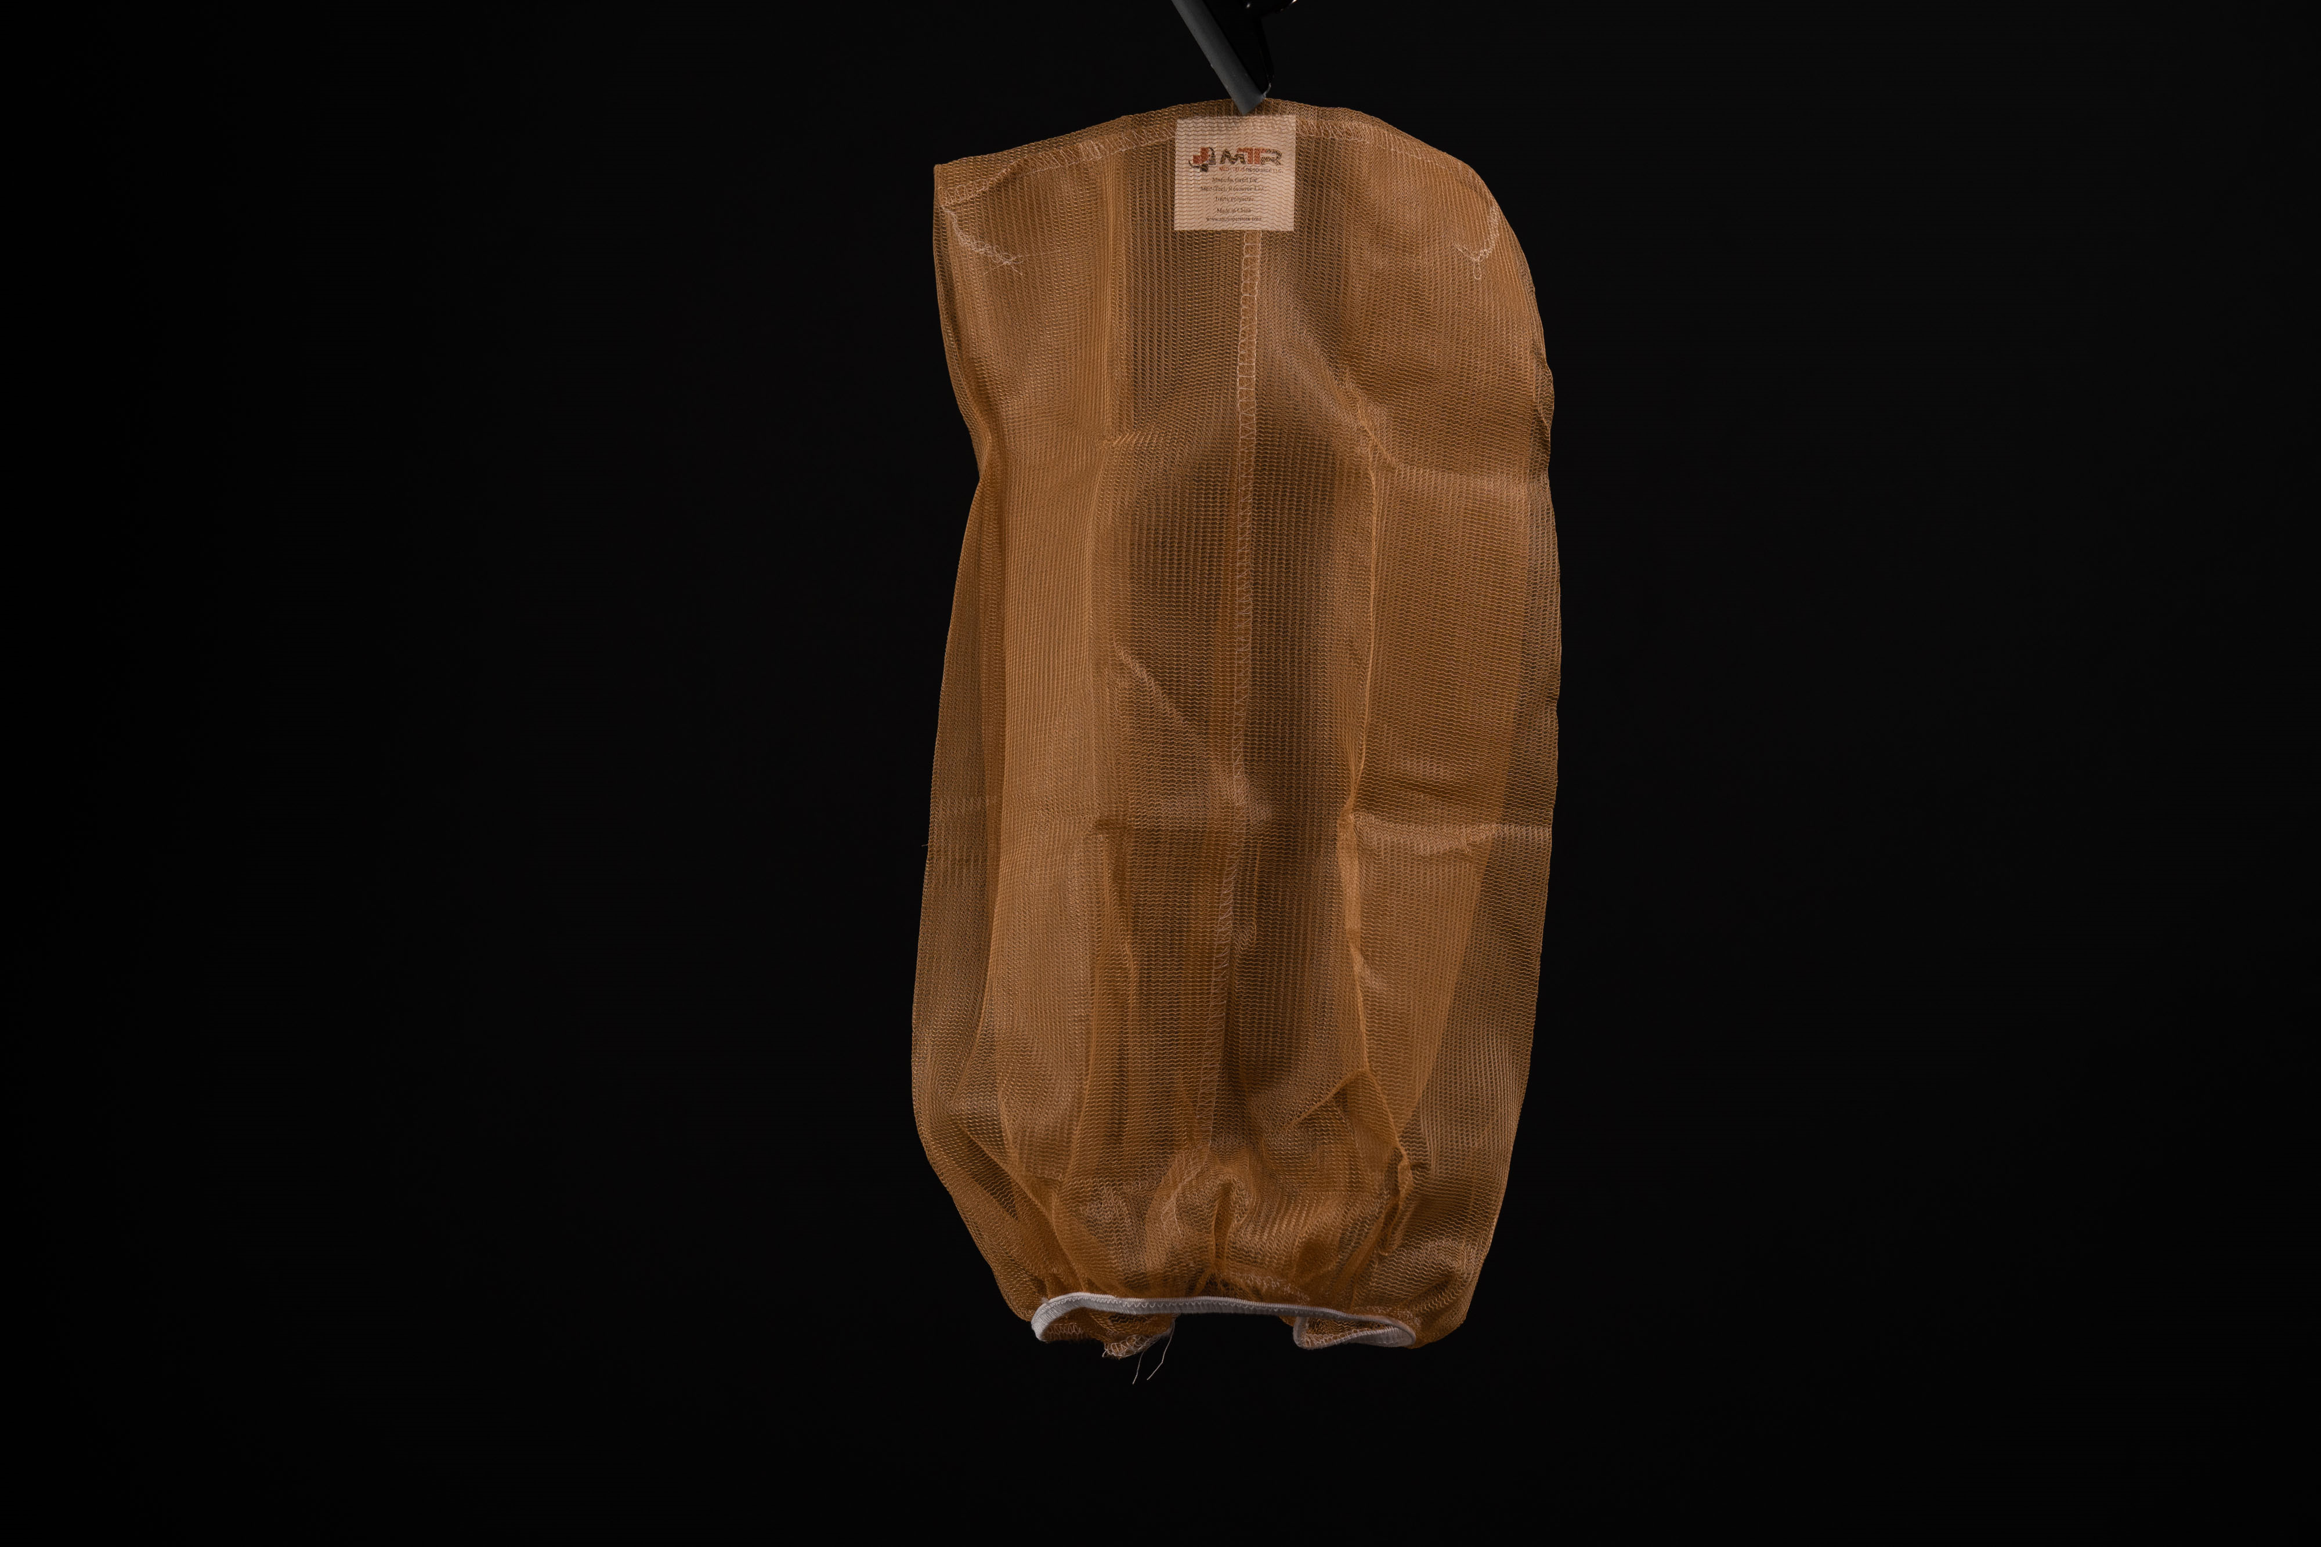
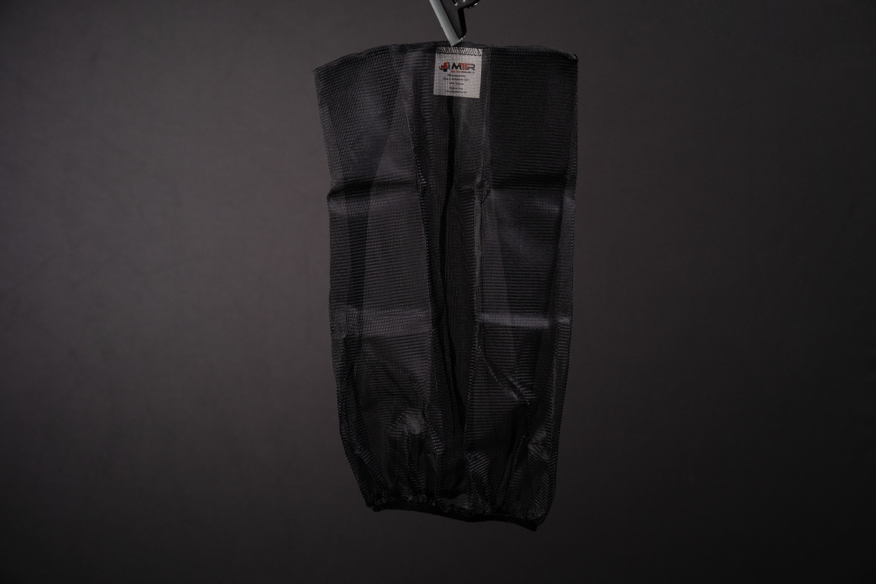
SPIT MASK EXAMPLES

Slide 12
HISTORICALLY
Hoods are a fashion statement.
Eastern Penitentiary (Philadelphia, 1800s) placed solid cloth hoods on prisoners before moving them within the facility.
Some convicts are hooded before execution.
Terrorists often hood their captives.

Slide 13
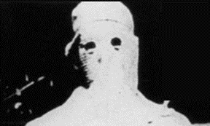
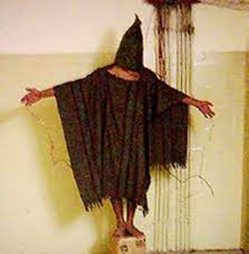
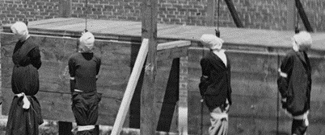
NEGATIVE HOOD PERCEPTIONS

Slide 14
IT IS NOT A HOOD!!!
Today, many people do not know what a “spit mask is.”
Today, applying any “device” over a person’s head and facial areas is often negatively perceived by some people.

Slide 15
IT IS NOT A HOOD!!!
The United Nations consider placing a “HOOD” on a individual as:
Cruel and
Torturous treatment of the individual
The United Nations considers placing a “HOOD” on an individual as:
Cruel and
Torturous treatment of the individual

Slide 16
OTHERS, TOO (in USA)

Slide 17
IMPORTANT QUESTION
Is Applying A Spit Mask A Use Of Force?

Slide 18
IMPORTANT ANSWER

Slide 19
SPIT MASK USE = USING FORCE
LEO using a spit mask must comply with:
Constitutional standards of care,
Any applicable more restrictive state statutory or regulatory standards, and/or
Agency policy on reporting force usage.

Slide 20
SPIT MASK USE = USING FORCE
Spit Mask application may be a de-escalation strategy.
Law enforcement officers must intervene if they become aware of something they perceive as being unreasonable.
Law enforcement officers must articulate the subject’s behaviors that induced spit mask application use, continued use, and removal.

Slide 21
SPIT MASK USE & AGENCY
Some agencies (think correctional) require a Spit Mask to be placed on anyone who is being moved within the facility.
Technically, this is a use of force, so document per agency and/or training administrative requirements.

Slide 22
Spit Mask
Medical Concerns

Slide 23
SPIT MASK MEDICAL CONCERNS
Cleanliness: Make sure the Spit Mask is new.
Abnormal breathing: Observed or reported (“I can’t breathe”).
Psychological: Claustrophobia, vision impairment, panic, agitation, Autism, mental illness.

Slide 24
SPIT MASK MEDICAL CONCERNS
Choking: Manipulation of the Spit Mask material into the mouth.
Suffocation: Aspiration of blood, vomit, etc.
Overheating: Complaint of becoming too hot.
Post-restraint: Struggle against restraints, LEOs.

Slide 25
Spit Mask
Application Guidelines

Slide 26
SPIT MASK APPLICATION GUIDELINES
What subject behaviors induced the application of a spit mask?
Was the spit mask applied as part of a de-escalation strategy?
Monitor the subject to see if (s)he puts contraband in the spit mask.
Keep contraband for evidence processing (biodegradable)

Slide 27
SPIT MASK APPLICATION GUIDELINES
Refer to your IPICD spit-restraint Device Learner Companion.
Follow
all applicable legal standards,
agency policy and training protocols, and/or
manufacturer product warning (if none, follow agency policy and training).

Slide 28
SPIT MASK APPLICATION GUIDELINES
Wear Personal Protective Equipment [PPE] (e.g., gloves).
Restrain the individual prior to Spit Mask application (e.g., handcuffs).
ONLY use agency-approved spit-restraint devices.

Slide 29
SPIT MASK APPLICATION GUIDELINES
ONLY agency competency trained and qualified LEOs are permitted to use spit-restraint devices.
Tell the individual why a spit-restraint device is being applied (if the totality of the circumstances permit it and it is safe).

Slide 30
SPIT MASK APPLICATION GUIDELINES
OPEN and REMOVE the spit-restraint device.
PREPARE the spit-restraint device for application per training and/or guidelines.
QUICKLY and SAFELY apply the spit-restraint device per training and/or policy.

Slide 31
SPIT MASK APPLICATION GUIDELINES
STOP the application if you have difficulty applying it (e.g., hat, large head, large hair, wig, physical movement, etc.).
DO NOT apply to anyone who is
Vomiting and/or
bleeding heavily from the mouth.

Slide 32
SPIT MASK APPLICATION GUIDELINES
DO NOT apply to anyone who is
bleeding heavily from the nose,
bleeding heavily from the facial area, and/or
having breathing difficulty.

Slide 33
SPIT MASK APPLICATION GUIDELINES
DO NOT apply to anyone
who complains of breathing difficulty (e.g., following OC spray).
for punishment or punitive purposes.
AVOID spraying a masked individual with an aerosol agent (depending upon the totality of the circumstances)

Slide 34
SPIT MASK APPLICATION GUIDELINES
Use two officers for spit-restraint device application (if practical)
Ensure the spit-restraint device is not
blocking vision and/or
interfering with ventilation.

Slide 35
SPIT MASK APPLICATION GUIDELINES
Make sure the spit-restraint device is not applying pressure to the person’s neck area.
Adjust the spit-restraint device (if necessary).
Monitor the individual (visual and auditory) for attempts to remove the device by “brushing” against objects.

Slide 36
SPIT MASK APPLICATION GUIDELINES
REMOVE the spit-restraint device if the person
complains of breathing difficulty, and/or
Vomits, and/or suffers heavy bleeding from the nose, mouth, facial area to prevent aspiration.

Slide 37
SPIT MASK APPLICATION GUIDELINES
Be aware some individuals may become extremely agitated and combative after a spit-restraint device is applied (i.e., person with Autism, mental illness, etc.).
Removal of the spit-restraint device may help calm them.
Decontaminate from aerosol spray residue (when safe).

Slide 38
SPIT MASK APPLICATION GUIDELINES
NEVER:
place the individual near a running vehicle’s exhaust and/or other dangerous fumes.
leave the person unattended (if practical).
permit the spit-restraint device to remain on an individual for an unreasonable period of time.

Slide 39
SPIT MASK APPLICATION GUIDELINES
Place a prone individual onto the side for better visual monitoring of the face and chest areas.
REMOVE the person from any area where smoke, gas, vehicle exhaust, and/or other dangerous fumes are present.
When reasonably safe, transport the individual, or arrange for transport, in an ambulance or agency vehicle.

Slide 40
Spit Mask Removal Guidelines

Slide 41
SPIT MASK REMOVAL GUIDELINES
Health and/or safety concerns:
Remove the spit-restraint device, per training.
Immediately begin health care protocols, per policy and training.
Wear Personal Protective Equipment (e.g., gloves, mask, etc.).

Slide 42
SPIT MASK REMOVAL GUIDELINES
Carefully remove the spit-restraint device avoiding injury to the facial, head, and/or neck areas.
Dispose of spit-restraint device per biohazard protocols (single use only), unless keeping for potential evidence.
Consider biodegradable timeline for substance processing.

Slide 43
SPIT MASK REMOVAL GUIDELINES
Document the subject’s behaviors and reason(s) for spit-restraint device application (e.g., person threatened to spit, did spit, etc.).
Document any application deviation from manufacturer warnings, agency policy, and/or training.
Provide report per agency guidelines (Paint pictures with words).

Slide 44
Spit Device Qualification Assessment

Slide 45
QUALIFICATION ASSESSMENTS
Next step, take the User-Level qualification assessment and/or performance evaluation.
You can use your Learner Companion and notes (Resource-based Learning).

Slide 46
REFERENCES
AELE-IPICD. (2021, April 28). Understanding and Managing Officer’s Use of Spit Masks [webinar].
AELE-IPICD, 2021.
Safariland, LLC. (2019). The Hood. Jacksonville, FL: Forensics Source; Stearns Wear, Inc. (n.d.) Spit Sock Hood; RIPP Restraints International, Inc. (n.d.). RIPP Restraints Protective Mask.
Graham v. Connor, 109 S. Ct. 1865 (1989)
Sullivan, A. (2010). A History of Hooding. Retrieved from dish.andrewsullivan.com/2010/04/30/a-history-of-hooding/; Williams, T., & Kinney, A. (2021, September 5). The American Horror of Hooding. Retrieved from newrepublic.com/article/159263/daniel-prude-rochester-new-york-spit-hood-history;
Kennedy, K. M., Payne-James, J. J., Payne-James, G. J., & Green, P. (2019). The use of spit guards (also known as spit hoods) by police services in England, Wales and Northern Ireland: to prevent transmission of infection or another form of restraint. Journal of Forensic and Legal Medicine, 66, 147-154.
Marigold, O., Castillo, E. M., Brennan, J., Coyne, C. J., Swift, S., & Vilke, G. M. (2020, May). Further study on the physiological effects of an alternative spit mask. J. Forensic Leg Med; Lutz, M. Sloane, C. M., Castillo, E. M., Brennen, J. J., Coyne, C. J., Swift, S.L., & Vilke, G.M. (2019, February). Physiological effects of a spit sock. Am J. Emerg Med, 291-293.
29 C.F.R. § 1910.1030

Slide 47
CREDITS
Copy: John G. Peters, Jr., M.S., M.B.A., M.A., Ph.D.
Photographer for IPICD: Curtis McCain
Instructional Design: John G. Peters, Jr., Ph.D., A. David Berman, M.S.
Learner Companion Design: www.curtnova.com
Peer review: D. Paul Matsenbaugh, M.D., Michael A. Brave, Esq., A. David Berman, M.S., Marilyn Janas, M.B.A., M.S.
Producer and Video Editor: Curtis McCain
Post-Production: Curtnova, Las Vegas, Nevada USA
Director, IPICD Digital Center: Jason W. Peters

Slide 48
THANK
YOU!

