Slide 1
Wheelchair: Contact & Control™ User-Level Program

Slide 2
Copyright Notice
Copyright 2017, Institute for the Prevention of In-custody Deaths, Inc. All rights reserved. No part of this publication may be reproduced, in whole or in part, in any form or by any means, without permission in writing from the publisher and the copyright owner.

Slide 3
Disclaimer
You agree by participating in this program the information contained herein is to be used only for informational purposes, and shall not be construed as medical, legal, psychiatric, and/or other advice.

Slide 4
Disclaimer cont’d
You agree by participating in this program the information contained herein is time sensitive, and users should consult with their respective medical, legal, psychiatric, and/or other professionals prior to using this information to make sure that it is current and has not become outdated, modified, and/or replaced with more current information.

Slide 5
Disclaimer cont’d
The information contained herein is provided to assist law enforcement administrators, officers, EMS providers, and others, and does not establish or create a standard of care, nor enhance applicable legal standards of care.

Slide 6
Disclaimer cont’d
The authors, the advisors, reviewers, and the publisher accept no liability whatsoever for any injuries to person or to property resulting from the application or the adoption of any of the information, procedures, tactics, or other considerations presented or contained in this document and/or training program.

Slide 7
Disclaimer
The information contained in the following slides was current when this presentation was developed. No one should rely on the information contained herein for an unreasonable period of time, as the scientific and medical research is constantly changing. To verify the accuracy of the information, please contact the IPICD, Inc.

Slide 8
Mission Statement
The Institute for the Prevention of In-Custody Deaths, Inc. (IPICD) is a clearinghouse, resource center, and training provider dedicated to providing interested parties with objective, timely, accurate, qualitative, and quantitative information, training, and operational guidance for the prevention and management of sudden- and in-custody deaths.

Slide 9
Contact Information
IPICD
209 South Stephanie Street
Suite B249
Henderson, Nevada 89012
866-944-4723
www.IPICD.com

Slide 10
Lesson: WHEELCHAIRS

Slide 11
WHEELCHAIRS
ADA WHEELCHAIR DEFINITION
“a manually operated or power-driven device designed primarily for use by an individual with a mobility disability for the main purpose of indoor, or both indoor and outdoor, locomotion” (www.adataorg).

Slide 12
WHEELCHAIRS
ANOTHER WHEELCHAIR DEFINITION
Kamenetz (1969), author of definitive text on wheelchairs:
“. . . Any chair on wheels . . . That can be propelled by the action of its occupant upon the chair itself” (p. 59).

Slide 13
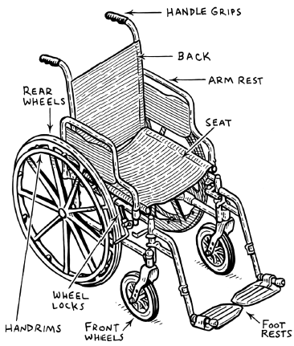
WHEELCHAIR NOMENCLATURE

Slide 14
WHEELCHAIRS
Today: more than 100 types of wheelchairs.
Estimation: about 3.3 million wheelchair users in the United States
Projection: annually increase, about 2 million people

Slide 15
Lesson: Americans With Disabilities Act

Slide 16
Disabilities and the Law
Americans with Disabilities Act of 1990 (ADA), and the ADA Amendments Act of 2008 (ADAAA).
Considered by many to be the second most important civil rights legislation to be passed by the United States Congress.

Slide 17
Disabilities and the Law
The ADA and the ADAAA defines the term disability:
A physical or mental impairment that substantially limits one or more major life activities of such individual;
A record of such an impairment; or
Being regarded as having such an impairment (24 U.S.C. §12012(1).

Slide 18
Disabilities and the Law
If any one of these criteria apply to a wheelchair user, (s)he may then be considered as having a disability, and is protected by federal law.

Slide 19
Disabilities and the Law
If disabled under federal law, Title II of the ADA makes it illegal for a public entity, such as a law enforcement agency, to exclude the person “from participation in or be denied the benefits of the services, programs, or activities of a public entity, or be subjected to discrimination by any such entity” (42 U.S.C. §12132).

Slide 20
Disabilities and the Law
Section 1630.2(h) Physical or Mental Impairment
Any physiological disorder, or condition, cosmetic disfigurement, or anatomical loss affecting one or more of the following body systems: neurological, musculoskeletal, special senses organs, respiratory (including speech organs), cardiovascular, reproductive, digestive, genitor-urinary, hemic and lymphatic, skin, and endocrine; or

Slide 21
Disabilities and the Law
Section 1630.2(h) Physical or Mental Impairment
Any mental or psychological disorder, such as mental retardation, organic brain syndrome, emotional or mental illness, and specific learning disabilities.

Slide 22
Disabilities and the Law
The terms disability and qualified individual with a disability does not include individuals currently engaging in the illegal use of drugs, when the covered entity acts on the basis of such use.
Drug means a controlled substance, as defined in schedules I through V of Section 202 of the Controlled Substances Act (21 U.S.C 812).

Slide 23
Lesson: Visible and Invisible Disabilities

Slide 24
Visible & Invisible Disabilities
Two disability categories:
Visible and
Invisible.
Visible disabilities = seen.

Slide 25
Visible & Invisible Disabilities
Visible disabilities include, but are not limited to:
hearing aid or cochlear implant,
wheelchair,
cane,
prosthesis,
amputations,
slurred speech, and/or
staggering gait or dragging a foot (Stonebrook, 2006).

Slide 26
Visible & Invisible Disabilities
Invisible disabilities not immediately apparent, and include, but are not limited to:
See page 16 of your wheelchair mini-book

Slide 27
Visible & Invisible Disabilities
About 1 of every 10 people in the United States is estimated to have invisible disabilities.
Individuals can have visible and invisible disabilities.

Slide 28
Lesson: Reasonable Accommodations & Modifications

Slide 29
Reasonable Accommodations & Modifications
Reasonable accommodation(s) may include:
Requesting an American Sign Language interpreter.
Obtaining a telephone for the deaf (TDD) or text telephone (TT),
Obtaining a wheelchair or other mobile assistive device,
Providing a cane or walker,

Slide 30
Reasonable Accommodations & Modifications
Transporting the individual in a special van or ambulance,
Providing physical assistance,
Using hand signals,
Asking another person to write down information for the individual, and/or
Handcuffing the person in the front.

Slide 31
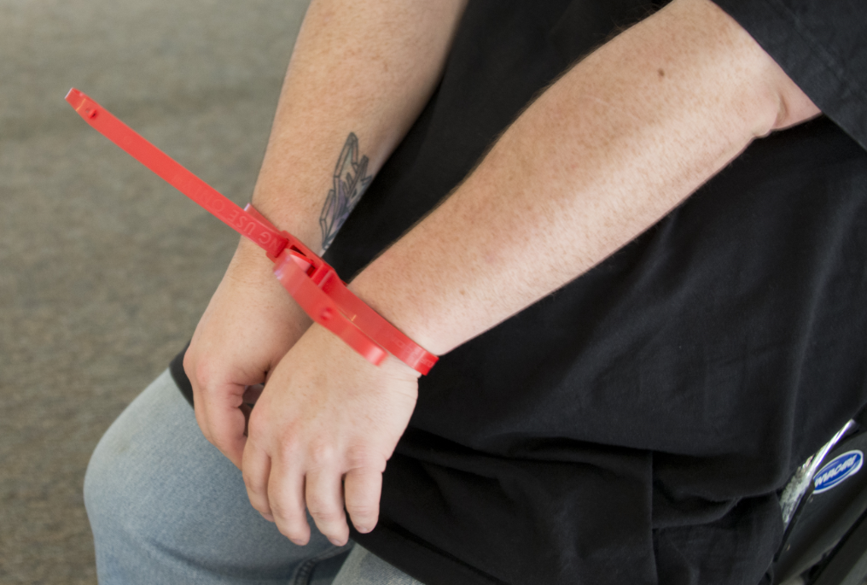
Reasonable Accommodations & Modifications
Handcuffing in the front

Slide 32
Reasonable Accommodations & Modifications
Multiple handcuffs in the rear

Slide 33
Reasonable Accommodations & Modifications
Remember: At issue is whether you caused the arrested person to suffer greater injury or indignity than other arrestees who were not disabled.
Document what you did or did not do, and why in your report.

Slide 34
Lesson: Prosthetics

Slide 35
Prosthetics
You may encounter wheelchair users who are wearing one or more artificial limbs.
Artificial limbs are called prosthetics.

Slide 36
Prosthetics
Prosthetics often use suspension system:
Elastic sleeve,
Straps,
Harness,
Vacuum,
Shuttle lock, and
Suction

Slide 37
Prosthetics
Prosthetics as Improvised Weapons
LEOs and others: Attacked by people using their prosthetic as an improvised weapon.
2010: Woman convicted of beating her boyfriend to death using her prosthetic leg.
1998: Washington state sheriff’s deputy was treated for head injuries after a man had beaten him with a prosthetic arm (Goad, 2014).

Slide 38
Prosthetics
Hook hands: can be dangerous weapons.
Remember: Wheelchairs are considered prosthetics.
Remember: Stay alert and maintain distance.

Slide 39
Lesson : Medical Devices & Appliances

Slide 40
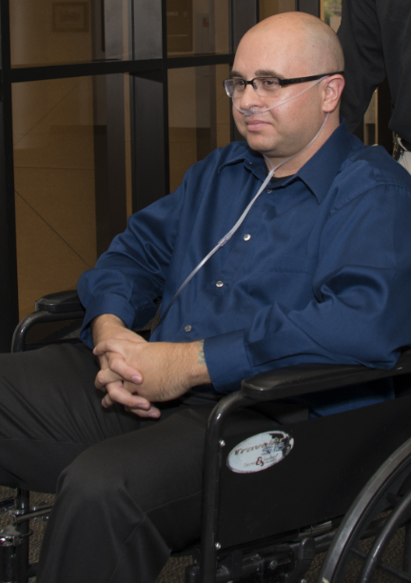
Medical Devices & Appliances
Wheelchair users: Often wear one or more attached medical devices and/or appliances that may be visible or not be visible.
Examples: Oxygen tank, nasal cannula.

Slide 41
Medical Devices & Appliances
Distraction: Seeing some medical appliances may be distracting.

Slide 42
Medical Devices & Appliances
Medical devices & appliances may include:
Hearing aid,
Catheters.
Urine collection bags,
Colostomy bags,
Anal bag,
Nasal Cannula, and/or
Oxygen tank holder.

Slide 43
Medical Devices & Appliances
Visually inspect: wheelchair user & wheelchair for medical devices and/or appliances.
Ask the wheelchair user and/or attendant if such devices and/or appliances are attached.

Slide 44
Medical Devices & Appliances
Remain vigilant when near a wheelchair user who uses supplemental oxygen.
Keep away flames or anything that could ignite the oxygen.
This includes the use of a TASER®.

Slide 45
Medical Devices & Appliances
Best practices (include, but not limited to):
Request EMS wheelchair user who is wearing a medical appliance or device.
Consider: the wheelchair user a patient (which (s)he is of a doctor), and
Consider: this a medical emergency.

Slide 46
Lesson: Disabled ≠ Not Dangerous

Slide 47
Disabled ≠ Not Dangerous
Riverside, California
May 13, 1982: Two police officers attempted to arrest Jackson Chambers Daniels, Jr. on a failure-to-appear arrest warrant for bank robbery.
Mr. Daniels was a paraplegic.

Slide 48
Disabled ≠ Not Dangerous
Officer Safety never takes a day off
Stay alert when dealing with everyone, including a individual who may have disabilities and/or be a wheelchair user.
Disabled individuals: May be armed; use the wheelchair as a weapon.

Slide 49
Disabled ≠ Not Dangerous
A wheelchair user may be able to:
Bite you;
Spit on you; and/or
Strike you with the wheelchair.

Slide 50
Questions
Are there any questions?
Next, together we will work on wheelchair navigation, pat downs, searches, and other relevant psychomotor skills.

